Slide 1
gRPC for fun and profit
By david emily

Slide 2


Who I am

Slide 3

Grpc
Google Remote Procedure Call
Operates over Http/2
Uses protocol buffers
Authentication
Bidirectional streaming

Slide 4
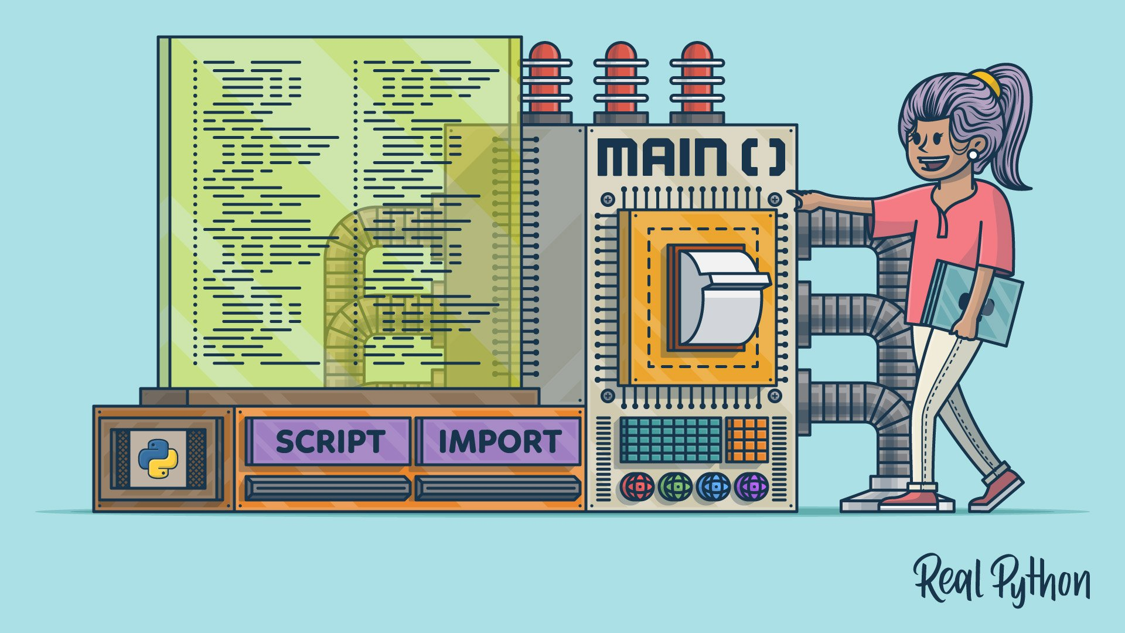
Monoliths
Monster systems unable to maintain or add new features.
Impossible to navigate code base.
Not fun.

Slide 5
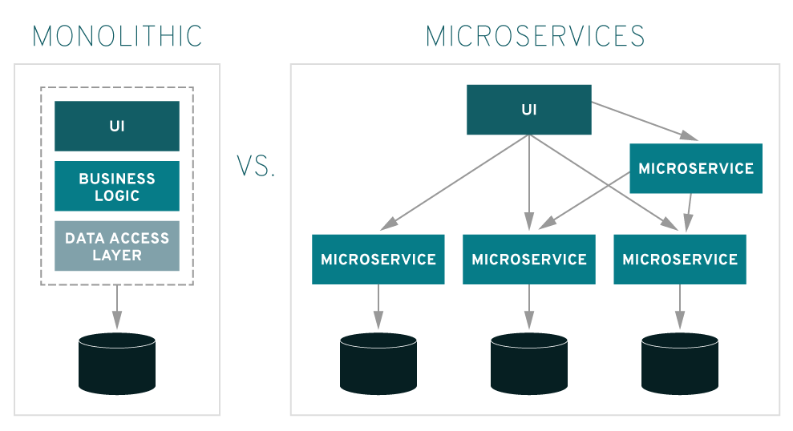
microservices
Breaking code into functions
Breaking monolith into small pieces
Everything does it’s own thing
Easier to work on and easier to maintain

Slide 6
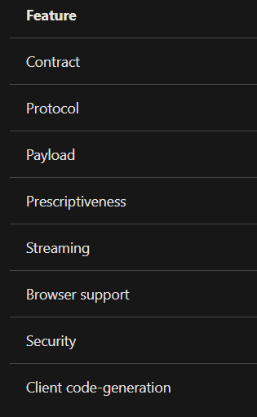
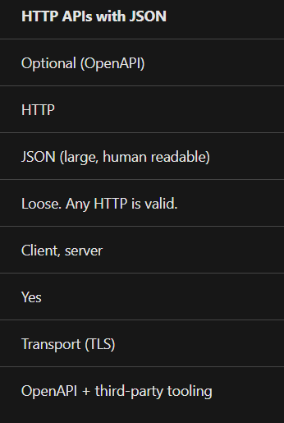
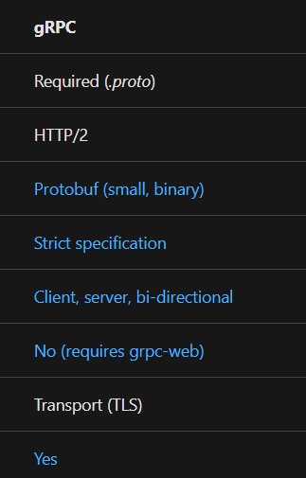
Web api

Slide 7
Performance
gRPC messages are serialized using Protobuf, an efficient binary message format. Protobuf serializes very quickly on the server and client. Protobuf serialization results in small message payloads, important in limited bandwidth scenarios like mobile apps.
gRPC is designed for HTTP/2, a major revision of HTTP that provides significant performance benefits over HTTP 1.x:
Binary framing and compression. HTTP/2 protocol is compact and efficient both in sending and receiving.
Multiplexing of multiple HTTP/2 calls over a single TCP connection. Multiplexing eliminates head-of-line blocking.
http://www.http2demo.io/

Slide 8
steaming
Streaming
HTTP/2 provides a foundation for long-lived, real-time communication streams. gRPC provides first-class support for streaming through HTTP/2.
A gRPC service supports all streaming combinations:
Unary (no streaming)
Server to client streaming
Client to server streaming
Bi-directional streaming

Slide 9
standard
Strict specification
A formal specification for HTTP API with JSON doesn't exist. Developers debate the best format of URLs, HTTP verbs, and response codes.
The gRPC specification is prescriptive about the format a gRPC service must follow. gRPC eliminates debate and saves developer time because gRPC is consistent across platforms and implementations.
https://packages.grpc.io/
https://developers.google.com/protocol-buffers/

Slide 10
Build a chat client
Npm init
Npm install –save grpc @grpc/proto-loader
Create protos folder

Slide 11
Protos folder
syntax = "proto3"; //Specify proto3 version.
package example;
service Chat { //Service class to be used by the clients
rpc join(stream Message) returns (stream Message){}
rpc send(Message) returns (Message){}
}
message Message {
string user = 1;
string text = 2;
}

Slide 12
server
// Receive message from client
function send(call, callback) {
notifyChat(call.request);
}
// Send message to all connected clients
function notifyChat(message) {
users.forEach(user => {
user.write(message);
});
}
// Define server with the methods and start it
server.addService(proto.example.Chat.service, { join: join, send: send });
server.bind(SERVER_ADDRESS, grpc.ServerCredentials.createInsecure());
server.start();
let grpc = require("grpc");
var protoLoader = require("@grpc/proto-loader");
const server = new grpc.Server();
const SERVER_ADDRESS = "0.0.0.0:5001";
// Load protobuf
let proto = grpc.loadPackageDefinition(
protoLoader.loadSync("protos/chat.proto", {
keepCase: true,
longs: String,
enums: String,
defaults: true,
oneofs: true
})
);
let users = [];
// Receive message from client joining
function join(call, callback) {
users.push(call);
notifyChat({ user: "Server", text: "new user joined ..." });
}

Slide 13
client
let username;
//Create gRPC client
let client = new proto.example.Chat(
REMOTE_SERVER,
grpc.credentials.createInsecure()
);
//Start the stream between server and client
function startChat() {
let channel = client.join({ user: username });
channel.on("data", onData);
rl.on("line", function(text) {
client.send({ user: username, text: text }, res => {});
});
}
//When server send a message
function onData(message) {
if (message.user == username) {
return;
}
console.log(`${message.user}: ${message.text}`);
}
//Ask user name then start the chat
rl.question("What's ur name? ", answer => {
username = answer;
startChat();
});
let grpc = require("grpc");
var protoLoader = require("@grpc/proto-loader");
var readline = require("readline");
//Read terminal Lines
var rl = readline.createInterface({
input: process.stdin,
output: process.stdout
});
//Load the protobuf
var proto = grpc.loadPackageDefinition(
protoLoader.loadSync("protos/chat.proto", {
keepCase: true,
longs: String,
enums: String,
defaults: true,
oneofs: true
})
);
const REMOTE_SERVER = "0.0.0.0:5001";

Slide 14
Start it
Node server
Node client

Slide 15
David emily
David.Emily@veteransunited.com
Github.com/david.emily
Veterans United is fun to work for

